Slide 1

EECS 370 - Lecture 18
Cache Blocks, Writeback, and Associativity
Live Poll + Q&A: slido.com #eecs370
Poll and Q&A Link

Slide 2
Announcements
P3 published
Checkpoint due today
5% of project – have pipeline working without data hazards or branches
Midterm scores published soon
HW 4 dueMonday

Slide 3
Resources
Want extra examples with pipelining? Try playing with the "Pipeline Simulator" under "Resources" on the website
https://vhosts.eecs.umich.edu/370simulators/pipeline/simulator.html
Several pre-written programs you can step through to understand what's going on
Note that the project pipeline is slightly different

Slide 4
Review: Memory Hierarchy
Problem: Large memory is much slower than processor
We'd have to wait ~100s of cycles for every load
Observation:
Small memory can be made as fast as processor
We only need a small amount of memory at a time
Idea: let's include a small amount of memory – a cache – that holds data hardware thinks is likely to be needed in the near future
Check the cache before going to main memory

Slide 5
Review: Memory Hiearchy
Managed explicitly by programmer / compiler
Small
Regs
Fast
Managed transparently by hardware
Caches
Big
Slow
Memory

Slide 6
Increasing Block Size
Memory
Tag
(case 1)
Tag
(case 2)
0
1
2
3
4
5
6
7
8
9
10
11
12
13
14
15
74
0
1
2
3
4
5
6
7
8
9
10
11
12
13
14
15
0
0
1
1
2
2
3
3
4
4
5
5
6
6
7
7
110
Case 1:
Block size: 1 bytes
120
1
0
74
1
6
160
130
V tag data (block)
140
How many bits needed per tag?
= log₂(number of blocks in memory) = log₂(16)
= 4 bits
Overhead = (4+1) / 8 = 62.5%
150
160
170
180
190
1
0
74
110
200
Case 2:
Block size: 2 bytes
1
3
160
170
210
V tag data (block)
220
230
How many bits needed per tag?
= log₂(number of blocks in memory) = log₂(8)
= 3 bits
Overhead = (3+1) / 16 = 25%
240
250
Poll: What will the overhead of this cache be?
Live Poll + Q&A: slido.com #eecs370

Slide 7
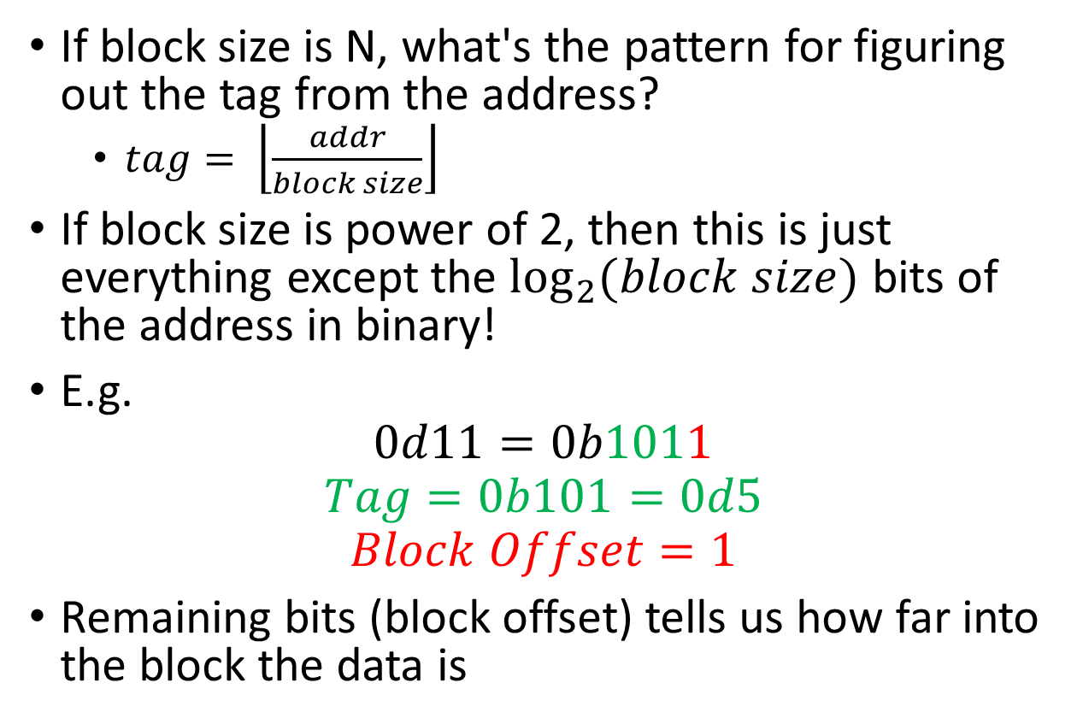
Figuring out the tag
Memory
Tag
(case 2)
0
1
2
3
4
5
6
7
8
9
10
11
12
13
14
15
74
0
0
1
1
2
2
3
3
4
4
5
5
6
6
7
7
110
Poll: What's the pattern?
120
If block size is N, what's the pattern for figuring out the tag from the address?
$tag= \left\lfloor \frac{addr}{block size}\right\rfloor$
If block size is power of 2, then this is just everything except the $\log_{2}{(block size)}$ bits of the address in binary!
E.g.
$$0d11=0b1011$$
$$Tag=0b101=0d5$$
$$Block Offset=1$$
Remaining bits (block offset) tells us how far into the block the data is
130
140
150
160
170
180
190
200
210
220
230
240
250
Live Poll + Q&A: slido.com #eecs370

Slide 8
Block size for caches
Processor
Cache
Memory
2 cache lines
3-bit tag field
2-byte block
0
1
2
3
4
5
6
7
8
9
10
11
12
13
14
15
100
110
120
Ld R1 ← M[ 1 ]
Ld R2 ← M[ 5 ]
Ld R3 ← M[ 1 ]
Ld R3 ← M[ 4 ]
Ld R2 ← M[ 0 ]
tag data
130
140
V
150
160
V
170
180
190
200
R0
R1
R2
R3
210
220
230
240
250

Slide 9
Block size for caches
Processor
Cache
Memory
0
1
2
3
4
5
6
7
8
9
10
11
12
13
14
15
100
110
120
Ld R1 ← M[ 1 ]
Ld R2 ← M[ 5 ]
Ld R3 ← M[ 1 ]
Ld R3 ← M[ 4 ]
Ld R2 ← M[ 0 ]
tag data
130
140
0
150
160
0
170
180
190
200
R0
R1
R2
R3
210
220
230
240
250

Slide 10
Block size for caches
Processor
Cache
Memory
0
1
2
3
4
5
6
7
8
9
10
11
12
13
14
15
100
110
120
Ld R1 ← M[ 1 ]
Ld R2 ← M[ 5 ]
Ld R3 ← M[ 1 ]
Ld R3 ← M[ 4 ]
Ld R2 ← M[ 0 ]
tag data
130
140
1
0
100
150
110
160
lru
0
170
180
block offset
190
Addr: 0001
200
R0
R1
R2
R3
210
110
Misses: 1
Hits: 0
220
230
240
250

Slide 11
Block size for caches
Processor
Cache
Memory
0
1
2
3
4
5
6
7
8
9
10
11
12
13
14
15
100
110
120
Ld R1 ← M[ 1 ]
Ld R2 ← M[ 5 ]
Ld R3 ← M[ 1 ]
Ld R3 ← M[ 4 ]
Ld R2 ← M[ 0 ]
tag data
130
140
1
0
100
150
110
160
lru
0
170
180
190
200
R0
R1
R2
R3
210
110
Misses: 1
Hits: 0
220
230
240
250

Slide 12

Block size for caches
Poll: Complete the last 3 instructions yourself
Processor
Cache
Memory
0
1
2
3
4
5
6
7
8
9
10
11
12
13
14
15
100
110
120
Ld R1 ← M[ 1 ]
Ld R2 ← M[ 5 ]
Ld R3 ← M[ 1 ]
Ld R3 ← M[ 4 ]
Ld R2 ← M[ 0 ]
tag data
130
140
lru
1
0
100
150
110
160
1
2
140
170
150
180
block offset
190
Addr: 0101
200
R0
R1
R2
R3
210
110
Misses: 2
Hits: 0
220
150
230
240
250
https://bit.ly/3zo4hpk

Slide 13
Block size for caches
Processor
Cache
Memory
0
1
2
3
4
5
6
7
8
9
10
11
12
13
14
15
100
110
120
Ld R1 ← M[ 1 ]
Ld R2 ← M[ 5 ]
Ld R3 ← M[ 1 ]
Ld R3 ← M[ 4 ]
Ld R2 ← M[ 0 ]
tag data
130
140
lru
1
0
100
150
110
160
1
2
140
170
150
180
190
200
R0
R1
R2
R3
210
110
Misses: 2
Hits: 0
220
150
230
240
250

Slide 14
Block size for caches
Processor
Cache
Memory
0
1
2
3
4
5
6
7
8
9
10
11
12
13
14
15
100
110
120
Ld R1 ← M[ 1 ]
Ld R2 ← M[ 5 ]
Ld R3 ← M[ 1 ]
Ld R3 ← M[ 4 ]
Ld R2 ← M[ 0 ]
tag data
130
140
1
0
100
150
110
160
lru
1
2
140
170
150
180
190
200
R0
R1
R2
R3
210
110
Misses: 2
Hits: 1
220
150
230
110
240
250

Slide 15
Block size for caches
Processor
Cache
Memory
0
1
2
3
4
5
6
7
8
9
10
11
12
13
14
15
100
110
120
Ld R1 ← M[ 1 ]
Ld R2 ← M[ 5 ]
Ld R3 ← M[ 1 ]
Ld R3 ← M[ 4 ]
Ld R2 ← M[ 0 ]
tag data
130
140
1
0
100
150
110
160
lru
1
2
140
170
150
180
190
200
R0
R1
R2
R3
210
110
Misses: 2
Hits: 1
220
150
230
110
240
250

Slide 16
Block size for caches
Processor
Cache
Memory
0
1
2
3
4
5
6
7
8
9
10
11
12
13
14
15
100
110
120
Ld R1 ← M[ 1 ]
Ld R2 ← M[ 5 ]
Ld R3 ← M[ 1 ]
Ld R3 ← M[ 4 ]
Ld R2 ← M[ 0 ]
tag data
130
140
lru
1
0
100
150
110
160
1
2
140
170
150
180
190
200
R0
R1
R2
R3
210
110
Misses: 2
Hits: 2
220
150
230
140
240
250

Slide 17
Block size for caches
Processor
Cache
Memory
0
1
2
3
4
5
6
7
8
9
10
11
12
13
14
15
100
110
120
Ld R1 ← M[ 1 ]
Ld R2 ← M[ 5 ]
Ld R3 ← M[ 1 ]
Ld R3 ← M[ 4 ]
Ld R2 ← M[ 0 ]
tag data
130
140
lru
1
0
100
150
110
160
1
2
140
170
150
180
190
200
R0
R1
R2
R3
210
110
Misses: 2
Hits: 2
220
150
230
140
240
250

Slide 18
Block size for caches
Processor
Cache
Memory
0
1
2
3
4
5
6
7
8
9
10
11
12
13
14
15
100
110
120
Ld R1 ← M[ 1 ]
Ld R2 ← M[ 5 ]
Ld R3 ← M[ 1 ]
Ld R3 ← M[ 4 ]
Ld R2 ← M[ 0 ]
tag data
130
140
1
0
100
150
110
160
lru
1
2
140
170
150
180
190
200
R0
R1
R2
R3
210
110
Misses: 2
Hits: 3
220
140
100
230
140
240
250

Slide 19
Extra Practice Problem
Processor
Cache
Memory
2 cache lines
2-bit tag field
4-byte block
0
1
2
3
4
5
6
7
8
9
10
11
12
13
14
15
78
29
120
123
Ld R0 ← M[ 3]
Ld R2 ← M[ 12]
Ld R3 ← M[ 15]
Ld R1 ← M[ 4]
Ld R2 ← M[ 9]
V tag data
71
0
150
162
173
18
0
21
33
R0
R1
R2
R3
28
19
200
210
225

Slide 20
Solution to Practice Problem
Ld R0 ← M[ 3]
Ld R2 ← M[ 12]
Ld R3 ← M[ 15]
Ld R1 ← M[ 4]
Ld R2 ← M[ 9]
V tag data
V tag data
V tag data
V tag data
V tag data
1
0
78
1
0
78
1
0
78
1
1
71
1
1
71
29
29
29
150
150
120
120
120
162
162
123
123
123
173
173
0
1
3
19
1
3
19
1
3
19
1
2
18
200
200
200
21
210
210
210
33
225
225
225
28

Slide 21
Solution to Practice Problem
Ld R0 ← M[ 3]
Ld R2 ← M[ 12]
Ld R3 ← M[ 15]
Ld R1 ← M[ 4]
Ld R2 ← M[ 9]
V tag data
V tag data
V tag data
V tag data
V tag data
1
0
78
1
0
78
1
0
78
1
1
71
1
1
71
29
lru
29
lru
29
150
150
120
lru
120
120
162
162
123
123
123
173
173
0
1
3
19
1
3
19
1
3
19
1
2
18
lru
200
200
200
21
210
210
lru
210
33
225
225
225
28
miss
miss
hit
miss
miss

Slide 22
Extra Class Problem
Poll: Answer the below questions
*We'll see later that this is called a "fully-associative cache"
Given a cache that works as we've described* with the following configuration: total size is 8 bytes, block size is 2 bytes, LRU replacement. The memory address size is 16 bits and is byte addressable.
How many bits are for each tag? How many blocks in the cache?
Tag = 16 – 1 (block offset) = 15 bits; 2 byte blocks, 8 bytes total = 4 blocks.
For the following reference stream, indicate whether each reference is a hit or miss: 0, 1, 3, 5, 12, 1, 2, 9, 4
M,H,M,M,M,H,H,M,M
What is the hit rate?
3/9 = 33 %
How many bits are needed for storage overhead for each block?
Overhead = 15 (Tag) + 1 (V) + 2 (LRU) = 18 bits
Live Poll + Q&A: slido.com #eecs370

Slide 23
"Way" explanation
A "way" in a cache is a particular location that a piece of memory could exist in
E.g. our last cache example was a "two-way" cache
Is it the same as the number of entries in the cache?
In this example, yes
But generally no. Hold on until we talk about set-associate caches
V
V
tag data

Slide 24
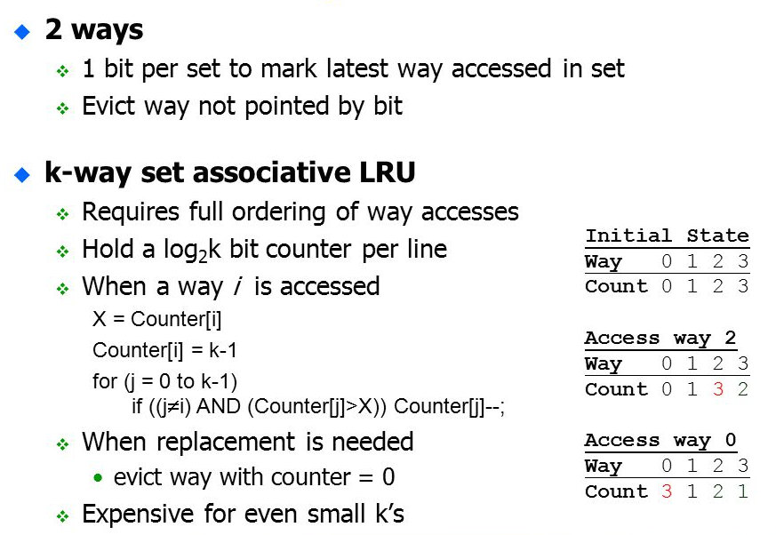
LRU Implementation with Counters

Slide 25
Spatial Locality
Notice that when we accessed address 1, we also brought in address 0
This turned out to be a good thing, since we later referenced address 0 and found it in the cache
This is taking advantage of spatial locality:
If we access a memory location (e.g. 1000), we are more likely to access a location near it (e.g. 1001) than some random location
Arrays and structs are a big reason for this

Slide 26
What about stores?
Where should you write the result of a store?
If that memory location is in the cache:
Send it to the cache.
Should we also send it to memory?
(write-through policy)
If it is not in the cache:
Allocate the line (put it in the cache)?
(allocate-on-write policy)
Write it directly to memory without allocation? (no allocate-on-write policy)

Slide 27
Handling stores (write-through, allocate on write)
Processor
Cache
Memory
0
1
2
3
4
5
6
7
8
9
10
11
12
13
14
15
78
29
120
V tag data
123
Ld R1 ← M[ 1 ]
Ld R2 ← M[ 7 ]
St R2 → M[ 0 ]
St R1 → M[ 5 ]
Ld R2 ← M[ 10 ]
71
0
150
162
0
173
18
Poll: How can we calculate the tag?
addr
floor(addr/2)
ceil(addr/2)
addr*2
21
33
R0
R1
R2
R3
28
Misses: 0
Hits: 0
19
200
210
225
Notes:
floor(addr/2)

Slide 28
write-through, allocate on write (REF 1)
Processor
Cache
Memory
0
1
2
3
4
5
6
7
8
9
10
11
12
13
14
15
78
29
120
V tag data
123
Ld R1 ← M[ 1 ]
Ld R2 ← M[ 7 ]
St R2 → M[ 0 ]
St R1 → M[ 5 ]
Ld R2 ← M[ 10 ]
71
0
150
162
0
173
18
21
33
R0
R1
R2
R3
28
Misses: 0
Hits: 0
19
200
210
225

Slide 29
write-through, allocate on write (REF 1)
Processor
Cache
Memory
0
1
2
3
4
5
6
7
8
9
10
11
12
13
14
15
78
29
120
V tag data
123
Ld R1 ← M[ 1 ]
Ld R2 ← M[ 7 ]
St R2 → M[ 0 ]
St R1 → M[ 5 ]
Ld R2 ← M[ 10 ]
71
1
0
78
150
29
162
lru
0
173
18
21
33
R0
R1
R2
R3
28
29
Misses: 1
Hits: 0
19
200
210
225

Slide 30
write-through, allocate on write (REF 2)
Processor
Cache
Memory
0
1
2
3
4
5
6
7
8
9
10
11
12
13
14
15
78
29
120
V tag data
123
Ld R1 ← M[ 1 ]
Ld R2 ← M[ 7 ]
St R2 → M[ 0 ]
St R1 → M[ 5 ]
Ld R2 ← M[ 10 ]
71
1
0
78
150
29
162
lru
0
173
18
21
33
R0
R1
R2
R3
28
29
Misses: 1
Hits: 0
19
200
210
225

Slide 31
write-through, allocate on write (REF 2)
Processor
Cache
Memory
0
1
2
3
4
5
6
7
8
9
10
11
12
13
14
15
78
29
120
V tag data
123
Ld R1 ← M[ 1 ]
Ld R2 ← M[ 7 ]
St R2 → M[ 0 ]
St R1 → M[ 5 ]
Ld R2 ← M[ 10 ]
71
lru
1
0
78
150
29
162
1
3
162
173
173
18
21
33
R0
R1
R2
R3
28
29
Misses: 2
Hits: 0
19
173
200
210
225

Slide 32
write-through, allocate on write (REF 3)
Processor
Cache
Memory
0
1
2
3
4
5
6
7
8
9
10
11
12
13
14
15
78
29
120
V tag data
123
Ld R1 ← M[ 1 ]
Ld R2 ← M[ 7 ]
St R2 → M[ 0 ]
St R1 → M[ 5 ]
Ld R2 ← M[ 10 ]
71
lru
1
0
78
150
29
162
1
3
162
173
173
18
21
33
R0
R1
R2
R3
28
29
Misses: 2
Hits: 0
19
173
200
210
225

Slide 33
write-through, allocate on write (REF 3)
Processor
Cache
Memory
0
1
2
3
4
5
6
7
8
9
10
11
12
13
14
15
173
29
120
V tag data
123
Ld R1 ← M[ 1 ]
Ld R2 ← M[ 7 ]
St R2 → M[ 0 ]
St R1 → M[ 5 ]
Ld R2 ← M[ 10 ]
71
1
0
173
150
29
162
lru
1
3
162
173
173
18
21
33
R0
R1
R2
R3
28
29
Misses: 2
Hits: 1
19
173
200
210
225

Slide 34
write-through, allocate on write (REF 4)
Processor
Cache
Memory
0
1
2
3
4
5
6
7
8
9
10
11
12
13
14
15
173
29
120
V tag data
123
Ld R1 ← M[ 1 ]
Ld R2 ← M[ 7 ]
St R2 → M[ 0 ]
St R1 → M[ 5 ]
Ld R2 ← M[ 10 ]
71
1
0
173
150
29
162
lru
1
3
162
173
173
18
21
33
R0
R1
R2
R3
28
29
Misses: 2
Hits: 1
19
173
200
210
225

Slide 35
write-through, allocate on write (REF 4)
Processor
Cache
Memory
0
1
2
3
4
5
6
7
8
9
10
11
12
13
14
15
173
29
120
V tag data
123
Ld R1 ← M[ 1 ]
Ld R2 ← M[ 7 ]
St R2 → M[ 0 ]
St R1 → M[ 5 ]
Ld R2 ← M[ 10 ]
71
lru
1
0
173
150
29
29
162
1
2
71
173
150
29
18
21
33
R0
R1
R2
R3
28
29
Misses: 3
Hits: 1
19
173
200
210
225

Slide 36
write-through, allocate on write (REF 6)
Processor
Cache
Memory
0
1
2
3
4
5
6
7
8
9
10
11
12
13
14
15
173
29
120
V tag data
123
Ld R1 ← M[ 1 ]
Ld R2 ← M[ 7 ]
St R2 → M[ 0 ]
St R1 → M[ 5 ]
Ld R2 ← M[ 10 ]
71
lru
1
0
173
29
29
162
1
2
71
173
29
18
21
33
R0
R1
R2
R3
28
29
Misses: 3
Hits: 1
19
173
200
210
225

Slide 37
write-through, allocate on write (REF 6)
Processor
Cache
Memory
0
1
2
3
4
5
6
7
8
9
10
11
12
13
14
15
173
29
120
V tag data
123
Ld R1 ← M[ 1 ]
Ld R2 ← M[ 7 ]
St R2 → M[ 0 ]
St R1 → M[ 5 ]
Ld R2 ← M[ 10 ]
71
1
5
33
29
28
162
lru
1
2
71
173
29
18
21
33
R0
R1
R2
R3
28
29
Misses: 4
Hits: 1
19
33
200
210
225

Slide 38
How many memory references?
Each miss reads a block
2 bytes in this cache
Each store writes a byte
Total reads: 8 bytes
Total writes: 2 bytes
but caches generally miss < 20%
Can we take advantage of that?
Multi-core processors have limited bandwidth between caches and memory
Extra stores also cost power

Slide 39

Next time
Write-back caches
Direct-mapped vs associative caches.
Lingering questions / feedback? I'll include an anonymous form at the end of every lecture: https://bit.ly/3oXr4Ah

